Slide 1
Kick-off Thesis Wesley
22nd of June 2017, 14:30
EWI HB11.130 or Skype

Slide 2
Research Question
Can one identify weaknesses in Android applications through feasible behavioral model learning?
RQ1: How can one extend model learning to be applicable to mobile applications?
Alphabet completeness, mobile parameters, definition of state
RQ2: How can we improve the feasibility of mobile application learning?
Learning algorithm, action substitution, event-tree in OT
RQ3: How can the learned model be used to assess the application's security?
What vulnerabilities can be identified in a model
Model enrichment

Slide 3
Validation
Correctness
From a self-made application
From a set of known vulnerable applications
Metrics
Time comparison

Slide 4
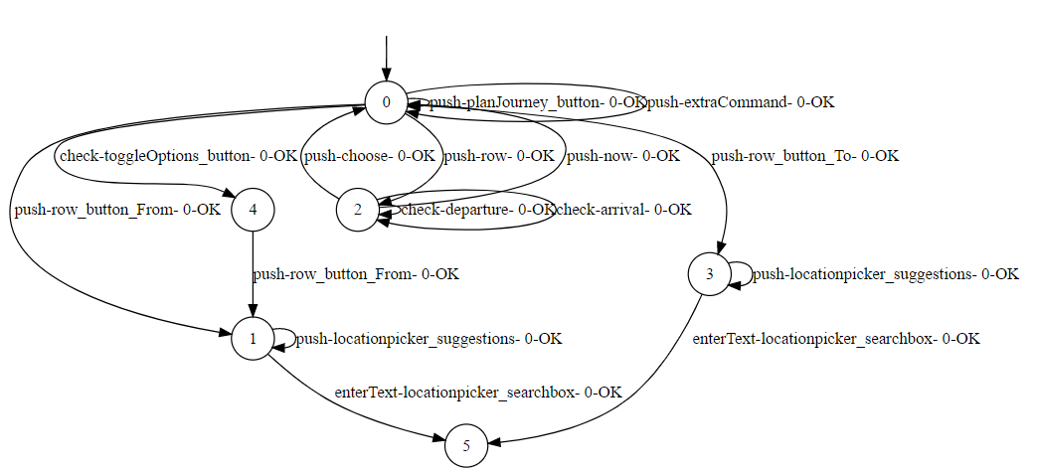
Current Situation
Modification of fsm-learner project
Only UI elements
>12 hours
Requires enrichment to assert weaknesses
Main screen model of 9292 application

Slide 5
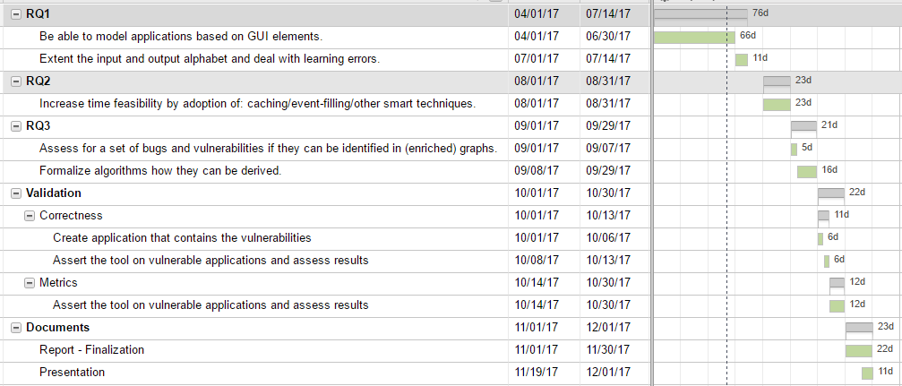
Planning

